Slide 1
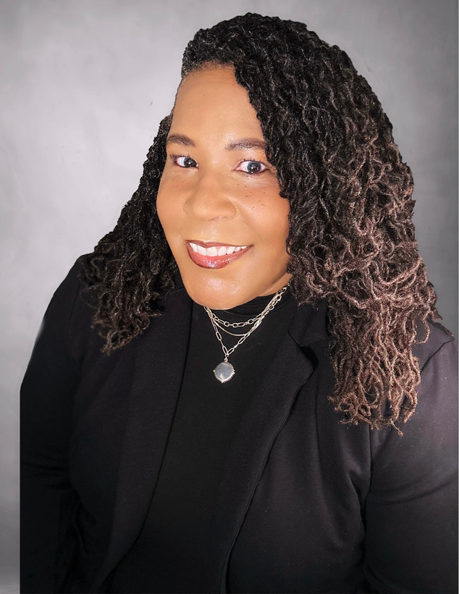


UI/UX DESIGN | PRODUCT MANAGEMENT
BeReal.
BeReal Passport And Community Boards
Enhancement Proposal • 2026
Presented by Lashawn Fofung, MBA, PMP, CSM, CSPO
Notes:
1

Slide 2
AGENDA
What we'll cover
01
Intro
Driving Authentic Daily Engagement & Long-Term Retention on BeReal.
02
The User Flow
Seven screens, one habit loop.
03
UI States Covered
Designed for more than the happy path.
04
MAU-Oriented Hooks
Invite people back - never pressure them.
05
The Prototype
BeReal Passport And Community Boards
2 / 16
Notes:
2

Slide 3
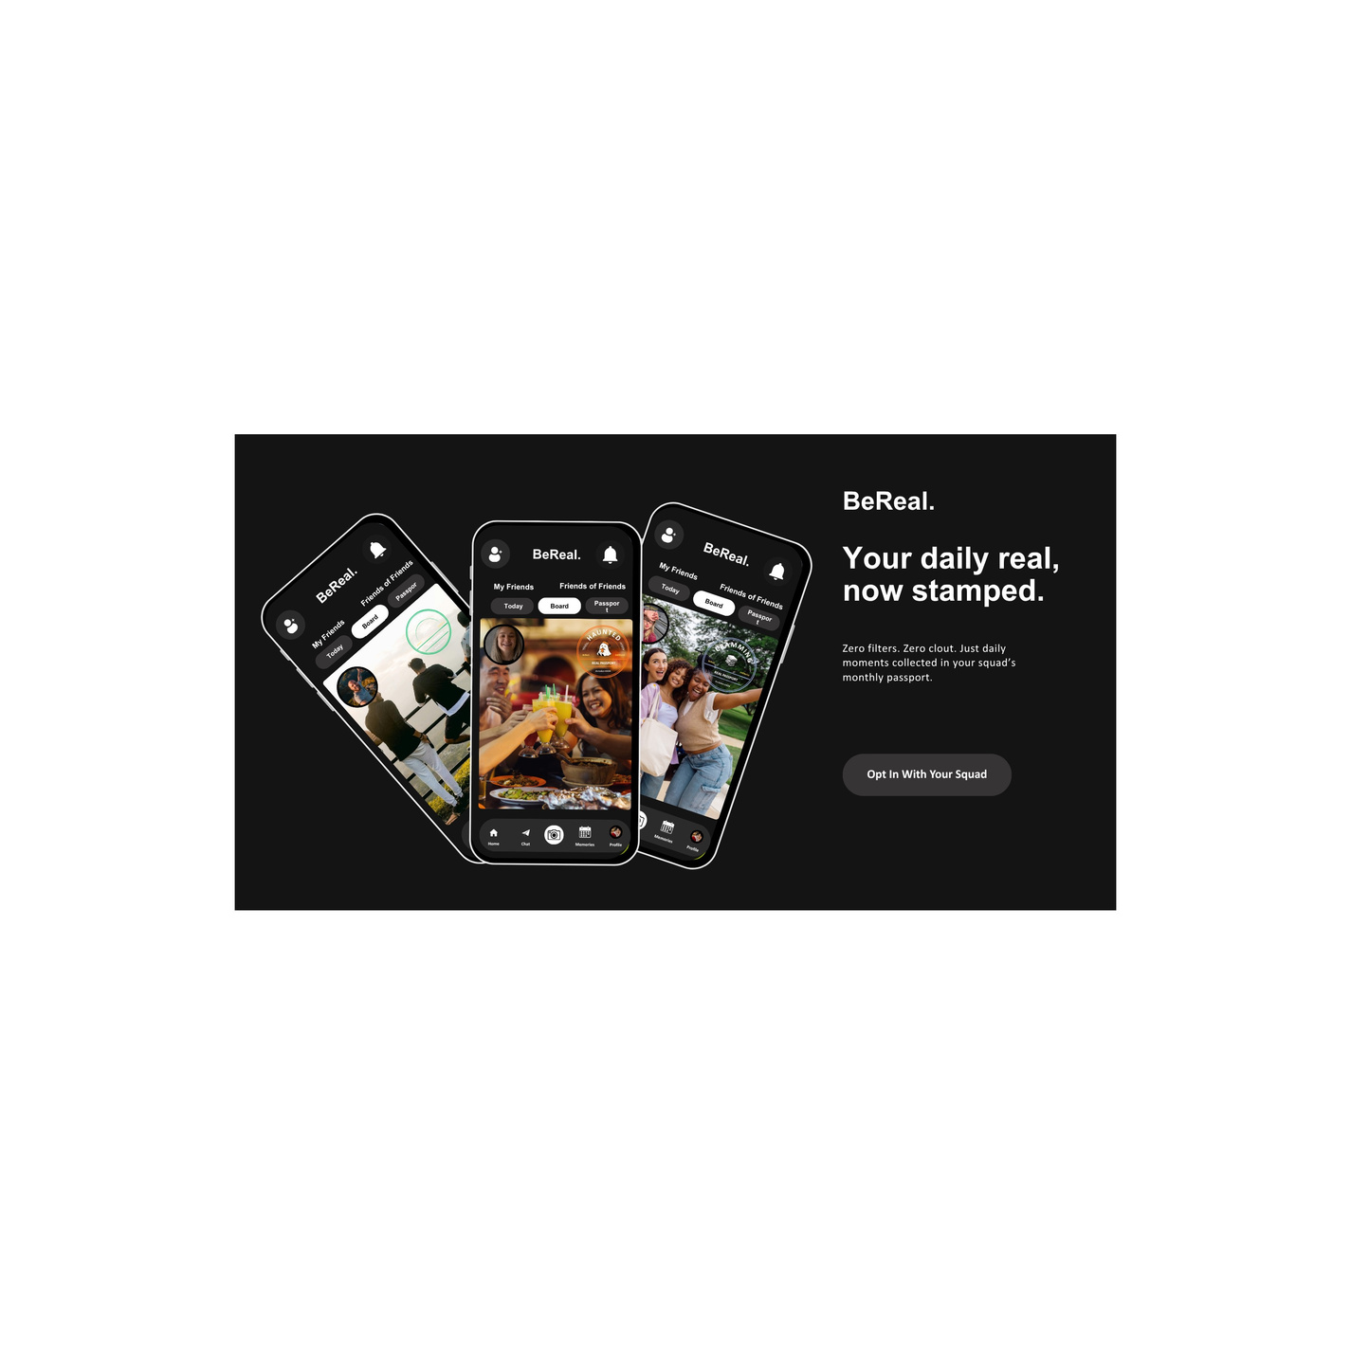
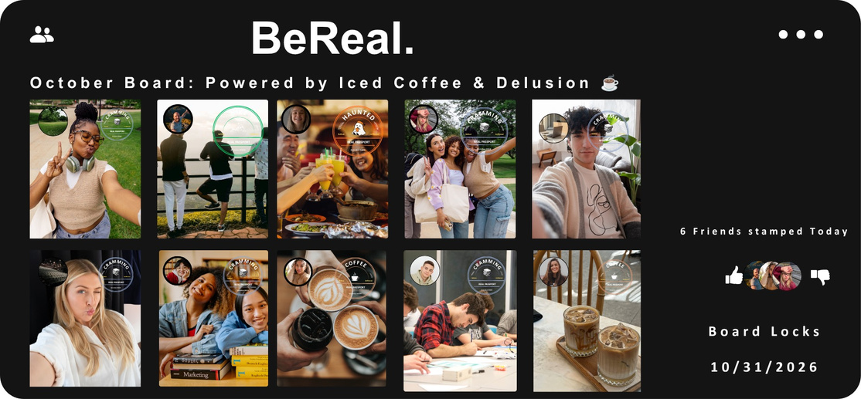
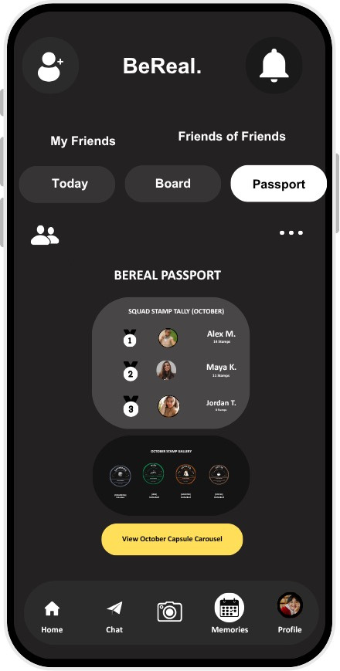

THE INTRO
Driving Authentic Daily Engagement & Long-Term Retention on BeReal.
THE PROBLEM STATEMENT
THE ENHANCEMENT
THE MAU IMPACT
  Post- Notification Slump
  Single-Touchpoint Limit
  Passive Feed Stagnation
  Casual Drop-Off Risk
  Midnight Theme Prompt
  Squad Board Collages
  Vector Passport Stamps
  Monthly Capsule Vault
  2.5x Daily Opens/User
  Organic Peer Accountability
  30-Day Retention Vaulting
  Zero Vanity Metric Loops
Time to Be Real.
Notes:
3

Slide 4
THE USER FLOW
Seven screens, one habit loop
The 7-screen happy path from start to finish.
1
2
3
4
Today Screen
→
Capture Toggle
→
Board Select
→
Post Confirm
5
6
7
Capsule / Board Detail
→
Passport & Leaderboard
→
Settings / Opt-out
↺ loops back to Today Screen the next day, with a fresh theme
First-time vs. repeat:
First-time users see a one-time intro overlay on Today Screen; repeat users land directly on the theme hero — no onboarding friction after day one.
Notes:
3

Slide 5
THE PROTOTYPE
A screen-by-screen rundown
Today Screen
Daily theme + reminder bubble + come-back banner
Capture Toggle
Theme Post / Random Post toggle + state demo panel
Board Select
Capsule collage, voting, comments, empty state
Post Confirm
Confirm to post photo to community board or usual post.
Capsule / Board Details
Choose to view capsule collection or see board details.
BeReal Passport
Stamp collection grid + streak cue
Leaderboard
Squad ranking + sponsor banner mockup
Settings / Opt-out
Control settings for name and password. User can opt-out of community board.
Notes:
6

Slide 6
EMOTIONAL TONE
In small amounts, calm, real, human.
“No one’s posted to this board yet — be the first!”
The empty state best captures BeReal’s tone — it would have been easy to leave this as a dead end or a guilt trip. Instead it stays warm and invitational, the same register BeReal uses everywhere else.
Notes:
6

Slide 7
UI STATES COVERED
Designed for more than the happy path
What happens when things are empty, loading , or go wrong.
🌱
⏳
🎉
⚠️
Empty
Loading
Success
Error
Board Selection / Capsule
Post Confirmation
Post Confirmation
Post Confirmation
“No one’s posted to this board yet — be the first!”
“Stamping your passport…”
“Stamp earned! Added to Coffee Shop 🎉”
“That didn’t go through — let’s try again.”
Notes:
4

Slide 8
MAU-ORIENTED HOOKS
Invite people back - never pressure them
👀
🔆
⏰
Reminder bubble
Soft streak cue
Come-back banner
“3 friends already posted to Coffee Shop today”
“You’ve been real 3 days in a row”
“Come back tomorrow for a new theme”
Social curiosity, not an alert
No loss framing, no streak-breaking guilt
Sets up tomorrow’s open without pushing it
BACK CAMERA — FULL FRAME FRONT CAMERA — OVERLAY
Notes:
5

Slide 9


FEATURE CONCEPT - OCTOBER 2026
BeReal.
BeReal.
BEREAL PASSPORT & COMMUNITY BOARDS
My Friends
Friends of Friends
Today
Board
Passport
Your daily BeReal,
now stamped.
Collect everyday moments with your squad. Create a shared monthly board, unlock playful passport stamps, and save the months as a capsule. No public likes. No filters. Just your people.
01 • Capture First
02 •Pick a Board
03 •Collect Stamps
04 •Archive Together
Prototype flow: Try to capture button, choose a community board after the photo, react to a board moment, and explore the Octorber Passport and Vault.
DESIGN PRINCIPLES
Home
Chat
Memories
Profile
Pitch-black canvas • Candid dual-camera feel • Tactile pastel stamp ink • Private squad reactions • Monthly collection loop

Slide 10
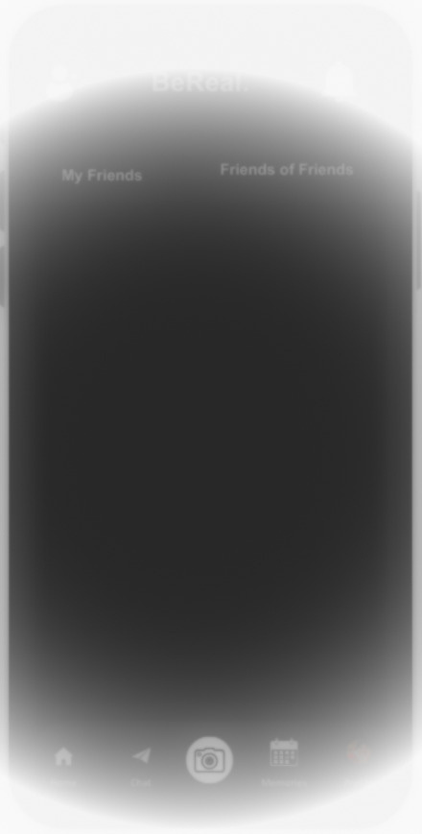


FEATURE CONCEPT - OCTOBER 2026
BeReal.
BeReal.
BeReal.
BEREAL PASSPORT & COMMUNITY BOARDS
My Friends
Friends of Friends
My Friends
Friends of Friends
Today
Board
Passport
Today Screen
(New User)
Opt-in to join Community Boards
⚠️ 12:00 AM Community Board open!!
Capture a moment to get your BeReal Passport.
Take a photo → Choose a Community Board → Real Passport Stamp added and posted to community board.
  User will receive an alert prompt at 12:00 AM their local time.
    Specific time to reset for tracking
  User opens app at their convenience
    Not dependent of Timed posting
  1 of 3 New Views for feature
  A button for user to opt-in to join Community Boards
    Opt-out default if user does not opt-in
To view your friends’ BeReal, share yours with them.
Post A BeReal.
To view your friends’ BeReal, share yours with them.
Post A BeReal.
Home
Chat
Memories
Profile
Home
Chat
Memories
Profile
User Receives Daily Alert
User Opens App

Slide 11

FEATURE CONCEPT - OCTOBER 2026
BeReal.
BeReal.
BeReal.
BEREAL PASSPORT & COMMUNITY BOARDS
Add a caption...
Capture Toggle
  User takes a photo
  Choose Post Type
    SEND
      Random Post
      No BeReal Passport
    COMMUNITY BOARD
      Themed Post
      Adds BeReal Passport to post
My Friends
ON
VIDEO
PHOTO
SEND
COMMUNITY
BOARD
User Takes Photo
Add Caption & Choose Post Type

Slide 12
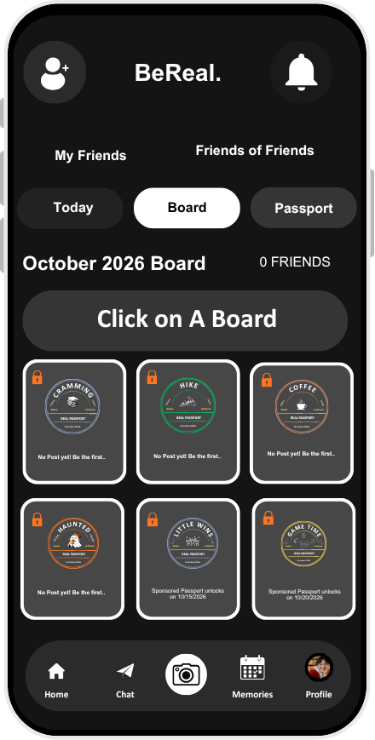
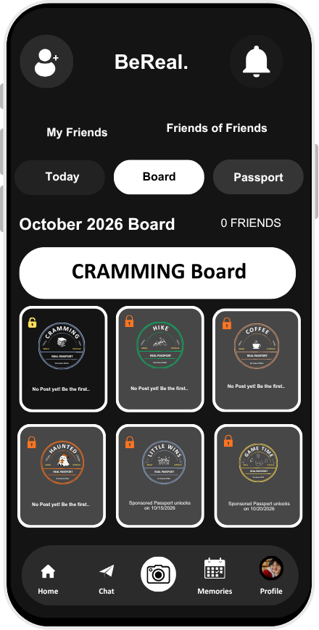
FEATURE CONCEPT - OCTOBER 2026
BeReal.
BEREAL PASSPORT & COMMUNITY BOARDS
Board Select
  Directed from Capture Screen to Board Screen
  User Chooses A Board
    Visual Confirmation
    Highlighted card switch from grey to white with name of selected board.
    Key Icon Changes from Lock to Unlock
User Chooses A
Board Chosen

Slide 13
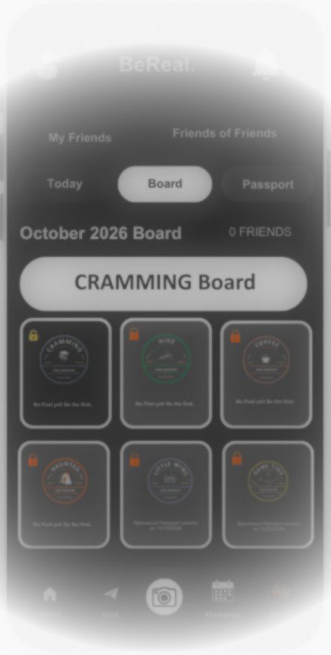
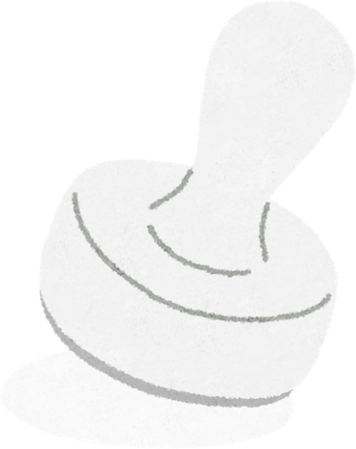

FEATURE CONCEPT - OCTOBER 2026
BeReal.
BeReal.
BeReal.
BEREAL PASSPORT & COMMUNITY BOARDS
My Friends
Friends of Friends
My Friends
Friends of Friends
Today
Board
Passport
Today
Board
Passport
Post Confirm
October 2026 Board
0 FRIENDS
October 2026 Board
0 FRIENDS
CRAMMING Board
CRAMMING Board
  Happy path messages:
    Loading
      “Stamping your passport..”
    Success
      “Stamp earned! Added to CRAMMING board🎉”
  If something goes wrong, a message will display:
    Empty state
      “No one’s posted to this board yet - be the first!”
    Error state
      “⚠️ That didn’t go through. Let’s try again.”
Stamping your passport..
Stamp earned! Added to CRAMMING board 🎉
CRAMMING
HIKE
COFFEE
CRAMMING
HIKE
COFFEE
BeReal.
REAL PASSPORT
Unfiltered
BeReal.
REAL PASSPORT
Unfiltered
BeReal.
REAL PASSPORT
Unfiltered
BeReal.
REAL PASSPORT
Unfiltered
BeReal.
REAL PASSPORT
Unfiltered
BeReal.
REAL PASSPORT
Unfiltered
October2026
October2026
October2026
October2026
October2026
October2026
No Post yet! Be the first..
No Post yet! Be the first..
No Post yet! Be the first..
No Post yet! Be the first..
No Post yet! Be the first..
No Post yet! Be the first..
HAUNTED
LITTLE WINS
GAME TIME
HAUNTED
LITTLE WINS
GAME TIME
BeReal.
REAL PASSPORT
Unfiltered
BeReal.
REAL PASSPORT
Unfiltered
BeReal.
REAL PASSPORT
Unfiltered
BeReal.
REAL PASSPORT
Unfiltered
BeReal.
REAL PASSPORT
Unfiltered
BeReal.
REAL PASSPORT
Unfiltered
October2026
October2026
October2026
October2026
October2026
October2026
No Post yet! Be the first..
Sponsored Passport unlocks on 10/15/2026
Sponsored Passport unlocks on 10/20/2026
No Post yet! Be the first..
Sponsored Passport unlocks on 10/15/2026
Sponsored Passport unlocks on 10/20/2026
Home
Chat
Memories
Profile
Home
Chat
Memories
Profile
Loading
Success

Slide 14
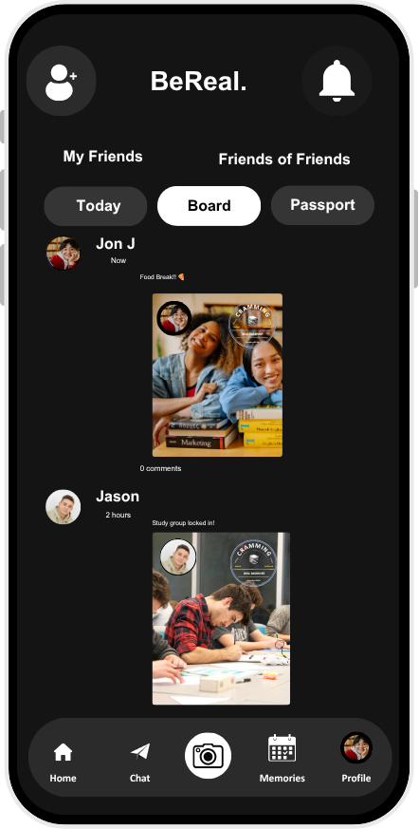
FEATURE CONCEPT - OCTOBER 2026
BeReal.
BEREAL PASSPORT & COMMUNITY BOARDS
Post Confirm
  Post added in Cramming Community Board feed
  User will see BeReal Passport stamp added to their photo
  User will be able to view other user’s community board post with BeReal Passport stamp

Slide 15
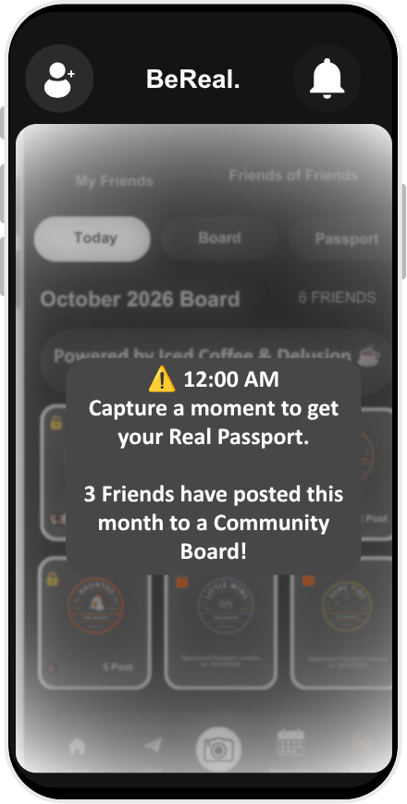
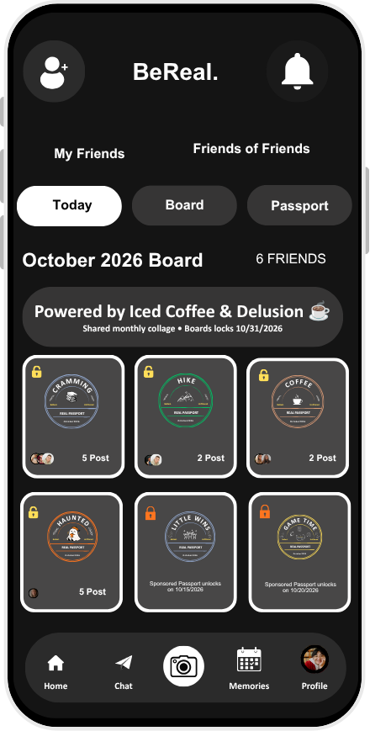
FEATURE CONCEPT - OCTOBER 2026
BeReal.
BEREAL PASSPORT & COMMUNITY BOARDS
Today Screen
(Returning User)
  MAU increase
  Daily Prompt
  Reminders
    Friends Posted to Board
    Streaks
    Comeback banner
  Once user has opt-in to join 1 or more community boards, ‘Today Screen’ will show October snapshot.
  Snapshot view of all the community boards available for the month (themed & sponsored)
  Each community board snapshot shows:
    State (locked or unlocked)
    Image of Real Passport stamp
    Friends who have posted
    Number of Post
Daily Prompt
Snapshot

Slide 16
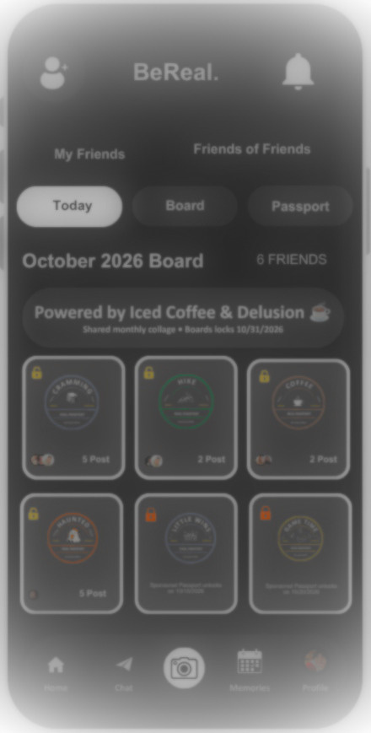
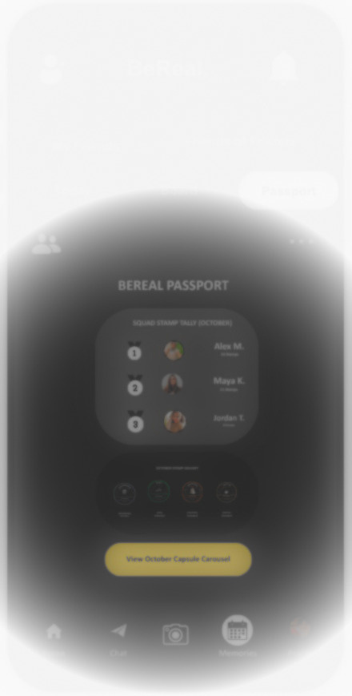


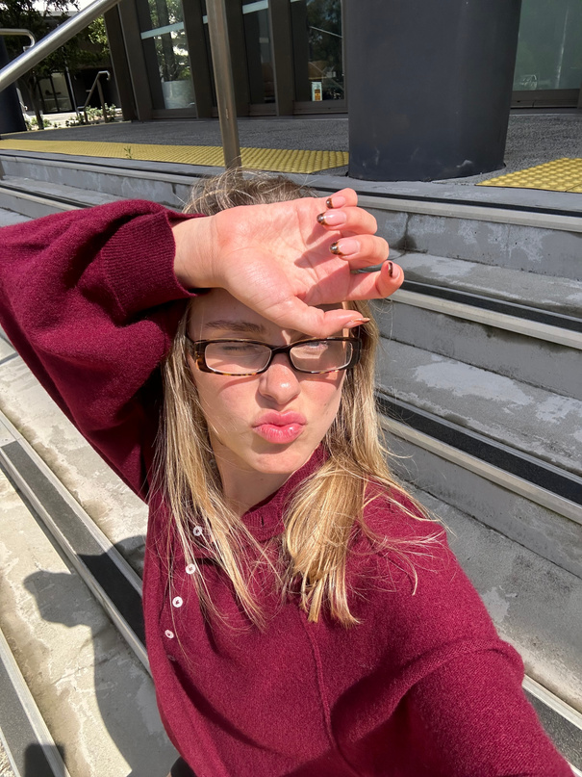
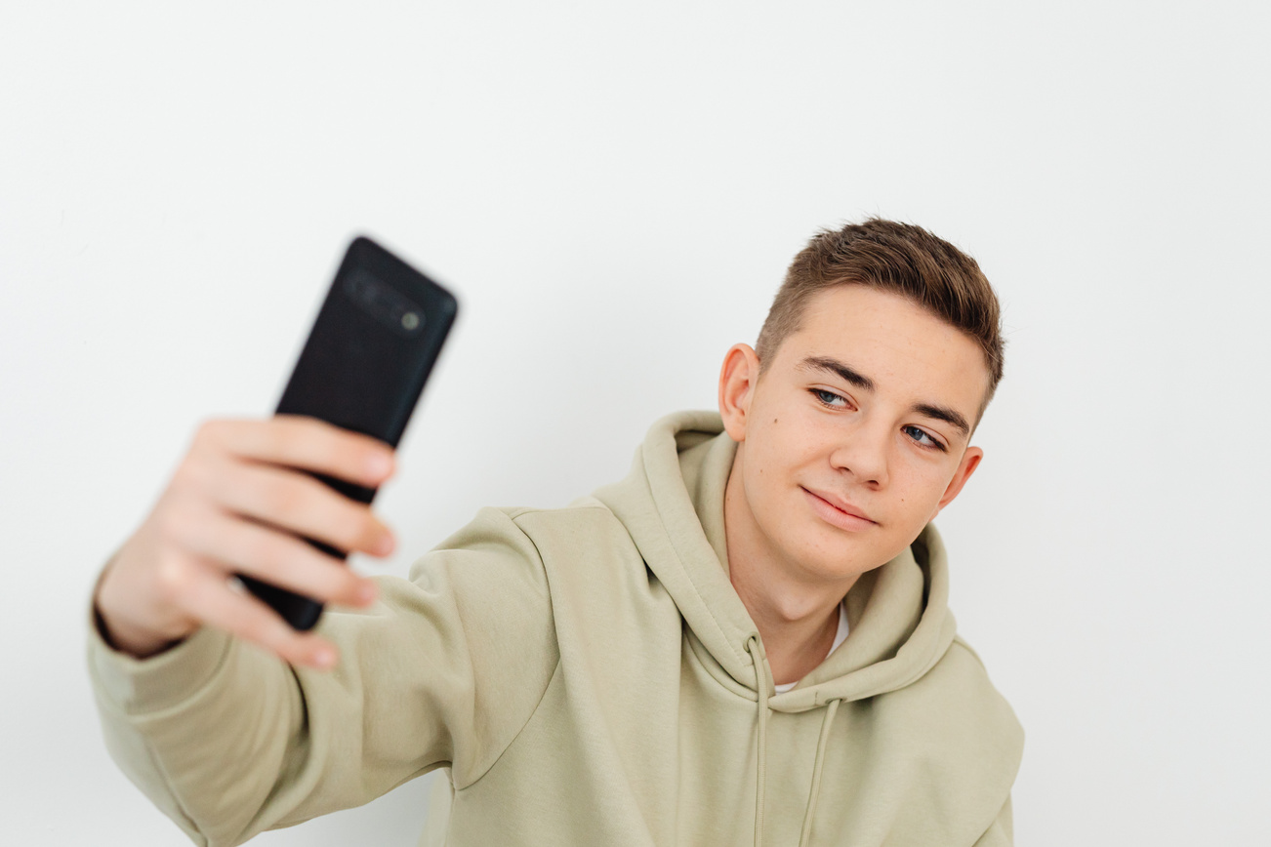






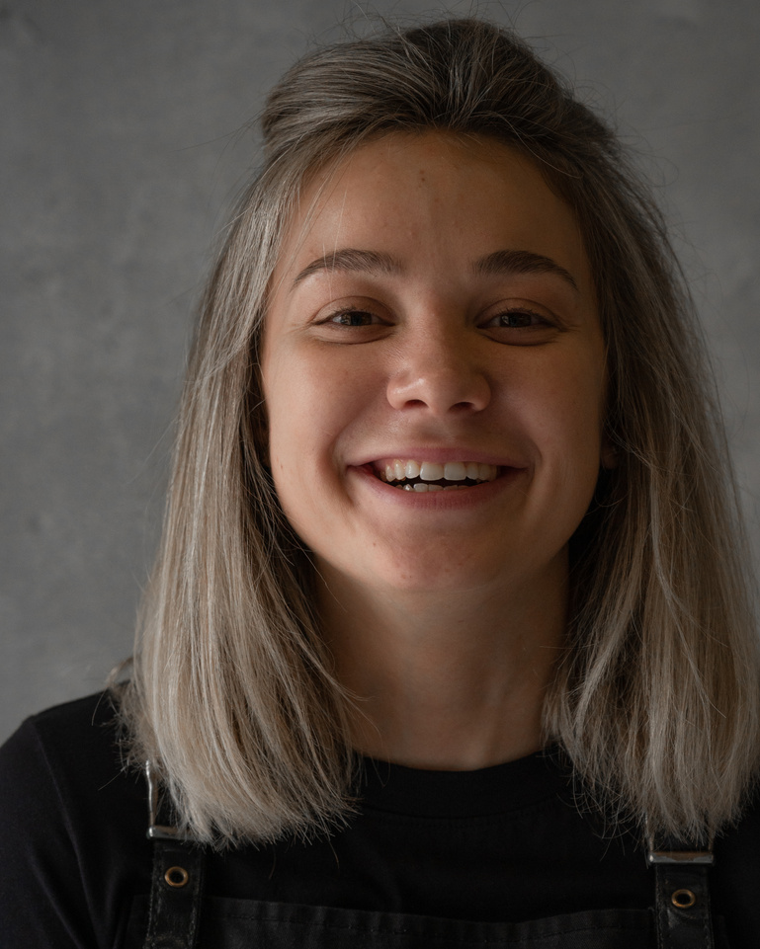
FEATURE CONCEPT - OCTOBER 2026
BeReal.
BeReal.
BeReal.
BEREAL PASSPORT & COMMUNITY BOARDS
My Friends
Friends of Friends
My Friends
Friends of Friends
Reminders
Today
Board
Passport
Today
Board
Passport
SUN Oct 18
October 2026 Board
6 FRIENDS
October 2026 Board
6 FRIENDS
  MAU increase
  Reminders
    Friends Posted to Board
      Social curiosity
    Streaks
      No loss framing
      No streak-breaking guilt
    Comeback banner
      Sets up for tomorrow’s engagement
  No pressure to post
8:33
Powered by Iced Coffee & Delusion ☕️
Shared monthly collage • Boards locks 10/31/2026
Powered by Iced Coffee & Delusion ☕️
Shared monthly collage • Boards locks 10/31/2026
☀️
You’ve been real 3 days in a row
⏰
Come back tomorrow for a new BeReal Passport
CRAMMING
HIKE
COFFEE
CRAMMING
HIKE
COFFEE
BeReal.
REAL PASSPORT
Unfiltered
BeReal.
REAL PASSPORT
Unfiltered
BeReal.
REAL PASSPORT
Unfiltered
BeReal.
REAL PASSPORT
Unfiltered
BeReal.
REAL PASSPORT
Unfiltered
BeReal.
REAL PASSPORT
Unfiltered
Notification Center
October2026
October2026
October2026
October2026
October2026
October2026
5 Post
2 Post
2 Post
5 Post
2 Post
2 Post
👀
3 Friends Have Posted To CRAMMING Board
HAUNTED
LITTLE WINS
GAME TIME
HAUNTED
LITTLE WINS
GAME TIME
BeReal.
REAL PASSPORT
Unfiltered
BeReal.
REAL PASSPORT
Unfiltered
BeReal.
REAL PASSPORT
Unfiltered
BeReal.
REAL PASSPORT
Unfiltered
BeReal.
REAL PASSPORT
Unfiltered
BeReal.
REAL PASSPORT
Unfiltered
October2026
October2026
October2026
October2026
October2026
October2026
5 Post
Sponsored Passport unlocks on 10/15/2026
Sponsored Passport unlocks on 10/20/2026
5 Post
Sponsored Passport unlocks on 10/15/2026
Sponsored Passport unlocks on 10/20/2026
Home
Chat
Memories
Profile
Home
Chat
Memories
Profile
Soft Streak Cue
Come-back Banner
Reminder Bubble

Slide 17
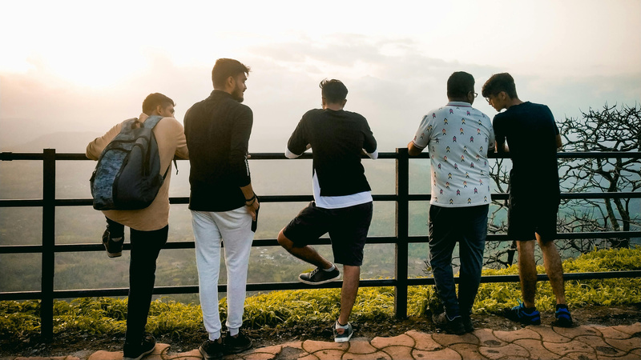
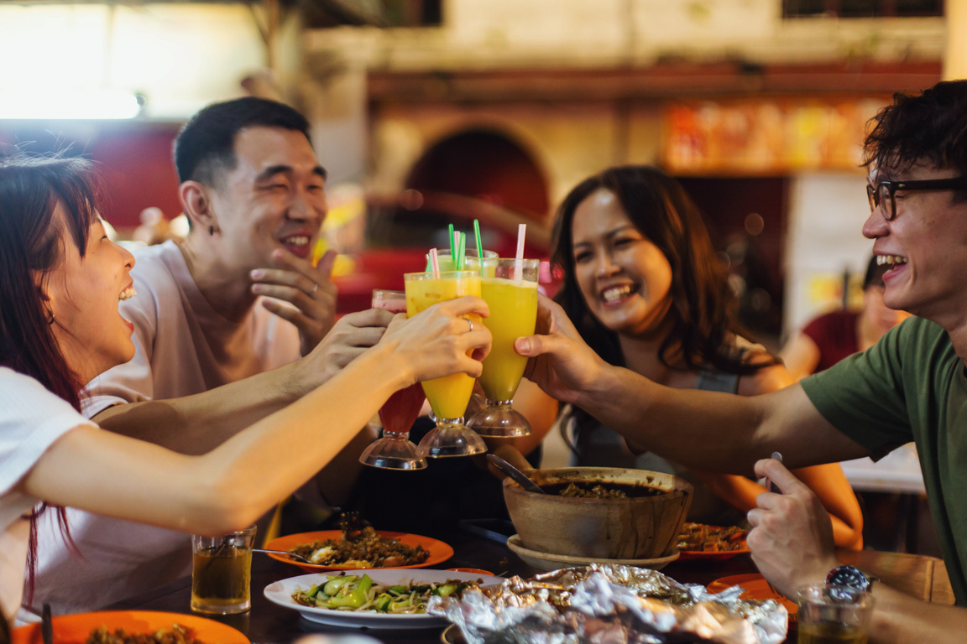

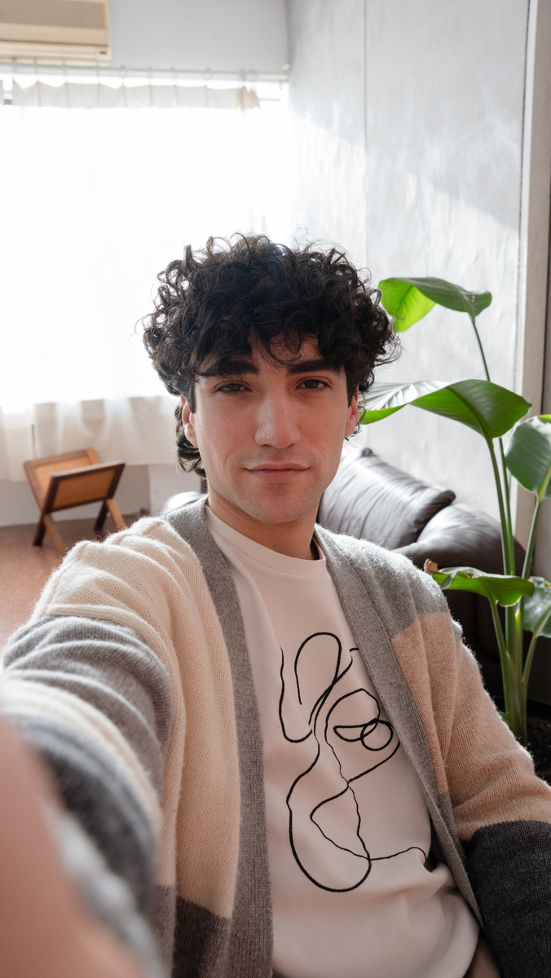
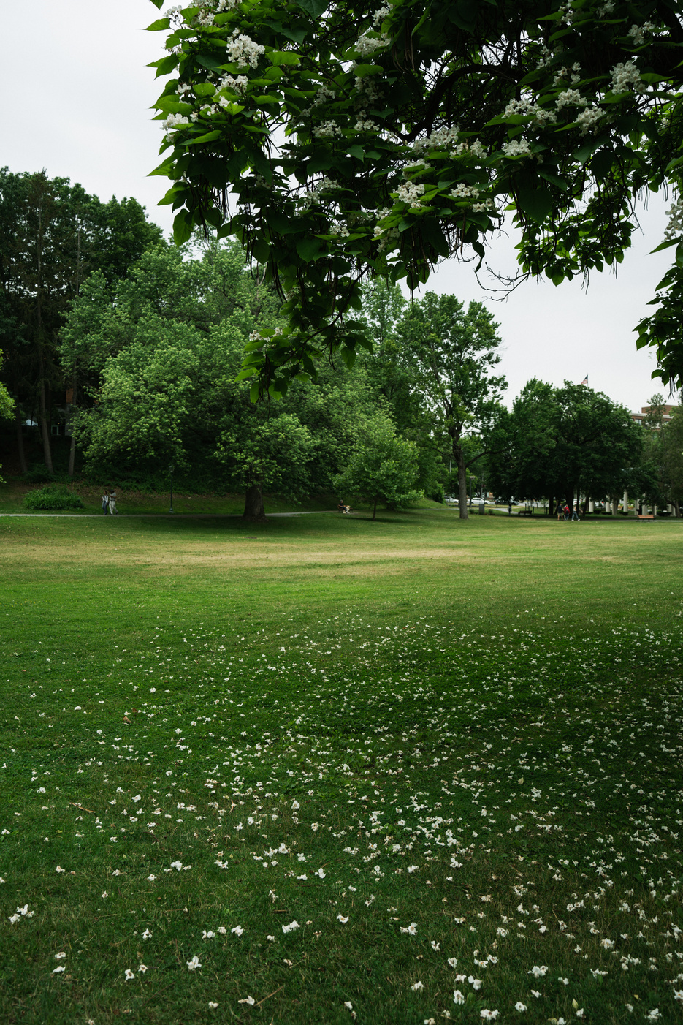

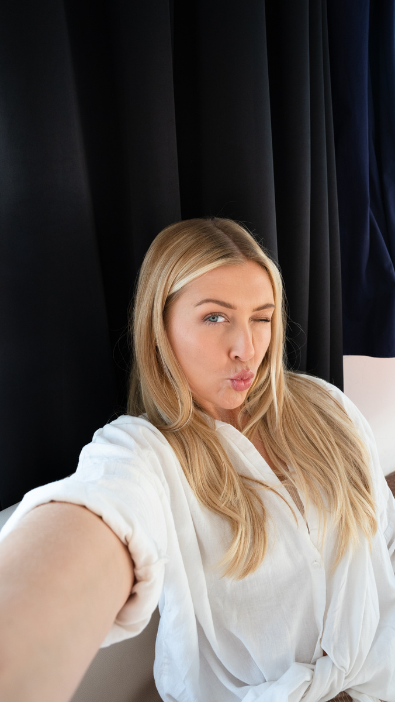

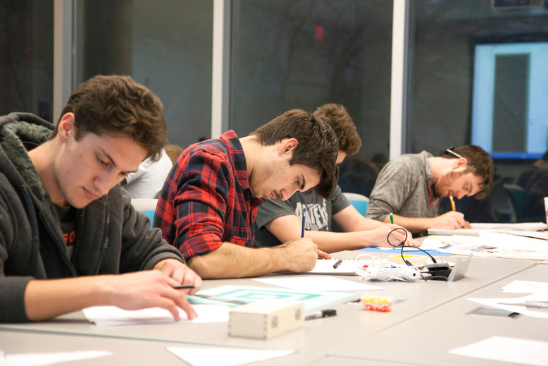
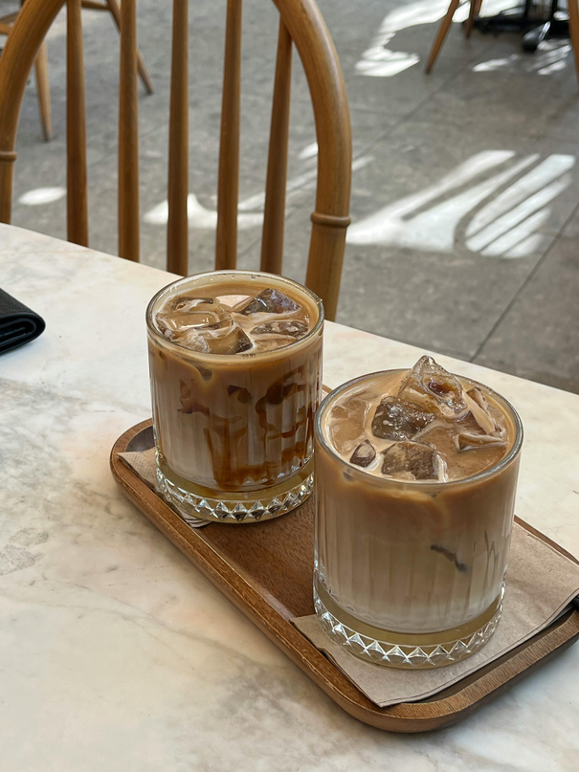
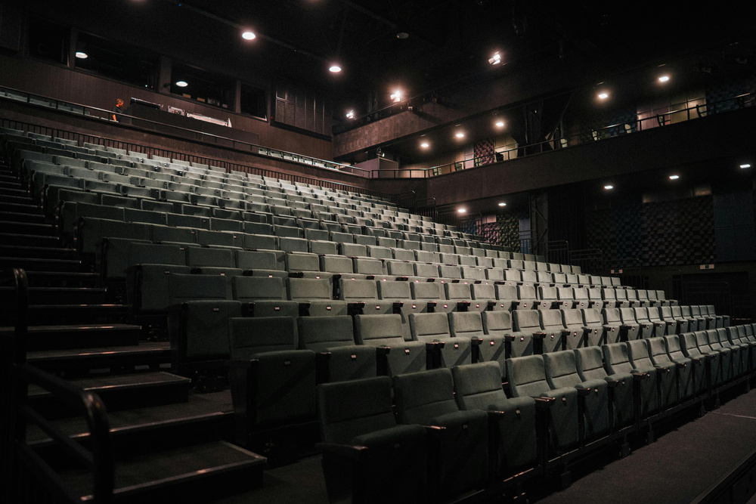
FEATURE CONCEPT - OCTOBER 2026
BeReal.
BeReal.
BEREAL PASSPORT & COMMUNITY BOARDS
My Friends
Friends of Friends
Capsule / Board Details
Today
Board
Passport
October 2026 Board: Powered by Iced Coffee & Delusion ☕️
  MAU increase
  Past Boards are stored in ‘Memories’ as a Capsule
    View all Community Boards Posting in a carousel view
  Carousel View
    Snapshot
    Expand out
      User can click on image to view post
      Future Enhancement
        2-Column Grid scroll
  Board details shows:
    Friends who participated
    Number of Likes or Dislikes
CRAMMING
HIKE
HAUNTED
CRAMMING
CRAMMING
BeReal.
REAL PASSPORT
Unfiltered
BeReal.
Unfiltered
BeReal.
Unfiltered
BeReal.
Unfiltered
BeReal.
Unfiltered
October2026
REAL PASSPORT
REAL PASSPORT
REAL PASSPORT
REAL PASSPORT
October2026
October2026
October2026
October2026
CRAMMING
CRAMMING
COFFEE
CRAMMING
COFFEE
BeReal.
REAL PASSPORT
Unfiltered
BeReal.
REAL PASSPORT
Unfiltered
BeReal.
REAL PASSPORT
Unfiltered
BeReal.
REAL PASSPORT
Unfiltered
BeReal.
REAL PASSPORT
Unfiltered
October2026
October2026
October2026
October2026
October2026
6 Friends stamped Today
Board Locks 10/31/2026
Home
Chat
Memories
Profile

Slide 18

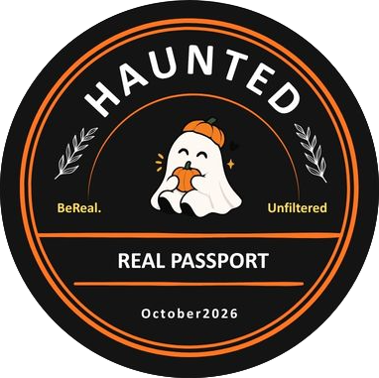

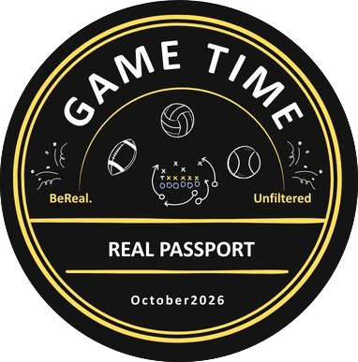


FEATURE CONCEPT - OCTOBER 2026
BeReal.
October 2026 Release
BEREAL PASSPORT & COMMUNITY BOARDS
BeReal Passport
  MAU increase
  New Theme Designs released monthly
  Sponsored Ad designs
  Gamified engangement
    Leadership board
  User can view their BeReal Passport Collection on the ‘Passport’ tab

Slide 19

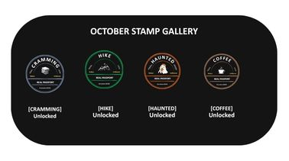
Leadership Board
FEATURE CONCEPT - OCTOBER 2026
BeReal.
SQUAD STAMP TALLY (OCTOBER)
Alex M.
14 Stamps
BEREAL PASSPORT & COMMUNITY BOARDS
Maya K.
11 Stamps
Leaderboard
Jordan T.
8 Stamps
  MAU Increase
  Design for push notification landing pages and in-app feature announcements.
  Leadership Board
  Passport Collection
  Quick Link to Capsule Carousel
User BeReal Passport
Collection
Button to Take User to Memories
View October Capsule Carousel

Slide 20


FEATURE CONCEPT - OCTOBER 2026
BeReal.
Settings
Settings
BEREAL PASSPORT & COMMUNITY BOARDS
Jon
Jon
Jon J
Jon J
Settings / Opt-out
FEATURES
Audio
Opt-in - Community Board
Opt-out - Community Board
COMMUNITY BOARD
  Manage Community Board(s) Participation
    Easily Opt-in or Opt-out
    Updated Setting Screen
    New screen to easily add or remove
SETTINGS
You can only opt-in or opt-out of current boards.
Choose board(s).
Notifications
CRAMMING
CRAMMING
ON
OFF
BeReal.
REAL PASSPORT
Unfiltered
Privacy
October2026
HIKE
BeReal.
HIKE
Unfiltered
ON
OFF
REAL PASSPORT
Email
ON
October2026
COFFEE
BeReal.
COFFEE
Unfiltered
ON
OFF
REAL PASSPORT
Time Zone: Americas
October2026
HAUNTED
HAUNTED
ON
OFF
BeReal.
REAL PASSPORT
Unfiltered
Other
October2026
GAME TIME
GAME TIME
ON
OFF
BeReal.
REAL PASSPORT
Unfiltered
ABOUT
October2026
LITTLE WINS
LITTLE WINS
ON
OFF
👀
BeReal.
REAL PASSPORT
Unfiltered
Share BeReal.
October2026
Rate BeReal.
Help
About
Log Out
Opt-in (Join)
or
Opt-out (Leave)
Version 4.99.2AB
Home
Chat
Memories
Profile
User Selects
Select Board(s)

Slide 21
THANK YOU
Be real.
Not polished.
Prototype — BeReal Passport And Community Boards
Prepared 2026
Presented by Lashawn Fofung, MBA, PMP, CSM, CSPO
Notes:
16

